Slide 1
An Analysis of Higher Education
Timothy Chien, Meenakshi Kavaseri, Rohit Rao, Harita Vellalath
Notes:
Alternative Title Suggestions:
College Choices
Choosing the Right School

Slide 2
Motivation
Education was a topic we could all relate to; We specifically wanted to learn more about what factors lead to both short and long-term career success
Other topics we were considering: Bitcoin/Blockchain, Cyber-Crime, Real Estate Foreclosures
We were also able to find education data from various sources
Notes:
Rohit

Slide 3
Questions
What is the cost and potential of Private vs Public Schools?
How important is the type of school to your earnings?
Does pursuing a STEM degree affect your earnings?
What are the college majors with the best/worst return on investment?
Notes:
Harita

Slide 4
Data
Kaggle .com
Payscale.com
StateUniversity.com
Notes:
Meena
Kaggle- where it takes to attend college- Salaries by college, region, and academic major.
College majors with the best return on investment → Top 5-10 (Kaggle)
College majors with the worst return on investment → Top 5-10 (Kaggle)
States with the best public colleges (Kaggle)
States with the worst public colleges (Kaggle)
2 year programs/vocational schools vs. 4 year programs (EPI, Payscale)
Are Ivy League schools worth the cost of investment? (Payscale)
Payscale - data sourced from surveys of employees curious about typical pay for people in the same position.
Stateuniversity.com-cost of attendence

Slide 5
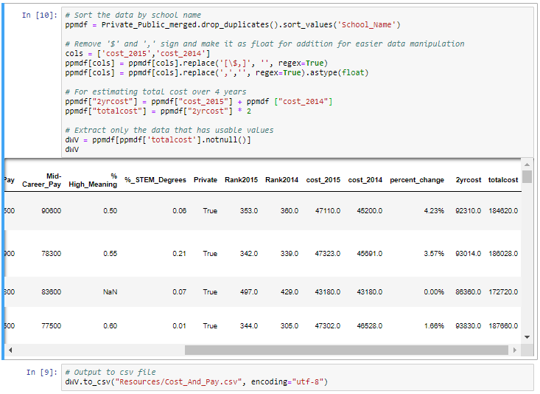
Data Cleanup & Exploration
Kaggle
Used multiple data files, merged and cleaned up as needed
Payscale.com
Collected data from the web page and cleaned punctuation for calculations
StateUniversity.com
Data was scraped off from the web-page, converted into a CSV file and cleaned for punctuation
Notes:
Meena

Slide 6
Private vs Public
Cost vs Early & Mid-Career Pay

Slide 7
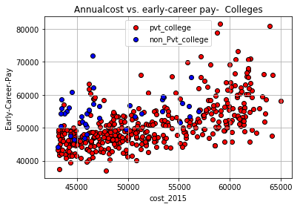
Data & Findings - Private vs. Public
Scatter plot based on cost of attending in 2015 vs. early career pay for both private and public colleges
Observations:
Private colleges- There seems to be a correlation between what you pay and what you earn as early-career pay.
The majority of the data points cluster around in the range of early $40,000s to mid $50,000s for both Cost and Pay.
Cost of non- private schools are comparatively lesser than the private schools.
For Public schools, there seems to be no real trend and data is less evenly distributed to draw conclusions.
Notes:
Meena
Scatter plots provide the correlation and distribution.
What I mean by non-private is public college which includes State school, naval academy, military school etc. the cost of non- private schools are comparatively lesser than the private schools.
Very limited data available for public colleges compared to private colleges.
State school, naval academy, military school etc. the cost of non- private schools are comparatively lesser than the private schools

Slide 8
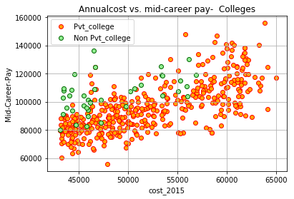
Data & Findings - Private vs. Public
Scatter plot based on costs in 2015 vs. Mid-career pay for both private and public colleges
Observations:
Mid career pay is the same trend as the early career pay for private colleges. The scale seems to follow a linear trend.
The trend for public colleges between early pay and mid career pay seems to be similar. No real trend.
Notes:
Meena

Slide 9
Importance of School Type to Your Potential Earnings

Slide 10
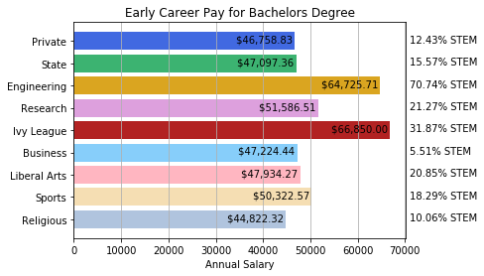
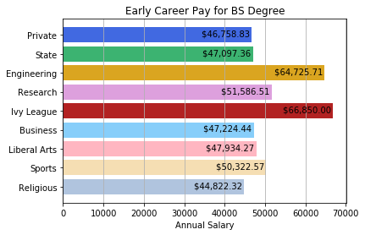
School Type Impact
Payscale Data and Classifications
Based off of median number from surveys
Not representative of all graduates
Not factoring in type-career mismatches
Classifications may overlap
Notes:
Tim
Payscale incentivises people to take the survey by offering information on compensation on others with similar backgrounds. Lack of incentive for minimum wage, or collective bargaining positions.
Complicated pay structures, like those of executives with low base salaries often skew the data downwards
Source data is all based off of medians of a pool of 54+M

Slide 11
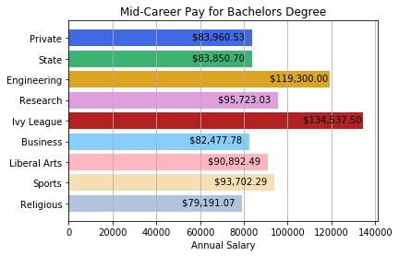
School Type Impact
Observations:
Attending an Ivy League (+43% / +60%), Engineering (+38% / +42%), Research (+10% / +14%) school or schools known for Sports (+7.6% / +11.6%) does seem to correspond to higher early and mid-career pay
Business school graduates do not seem to vary much from the public/private averages (within 2%)
Religious (-4.1% / -5.7%) school graduates tend to average below that of public/private schools
Notes:
Tim
Private Schools - 940
State Schools - 568
Engineering - 35
Research - 304
Ivy League - 8
Business - 45
Liberal Arts - 213
Sport - 305

Slide 12
Impact (if any) of STEM Major on Potential Earnings

Slide 13
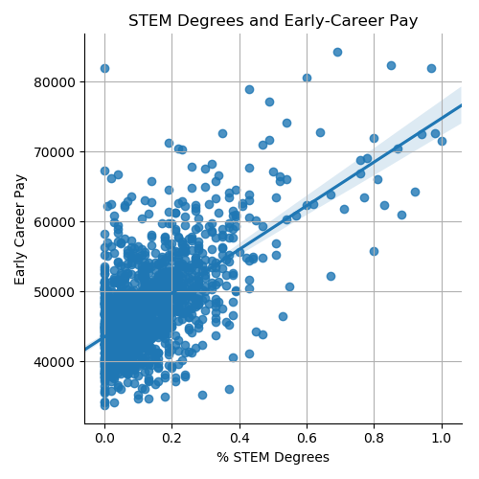
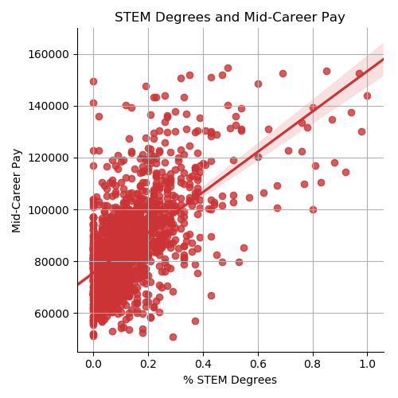
Findings - Value of STEM Major
Scatter plot with Seaborn used to model correlation between “% STEM Degrees” and “Early/Mid-Career Pay”
% STEM Degrees = Percentage of degrees awarded in Science, Technology, Engineering, and Mathematics per college
Positive correlation exists between the percentage of STEM degrees awarded and early/mid-career salaries of graduates, as demonstrated by trendline
Notes:
Rohit

Slide 14
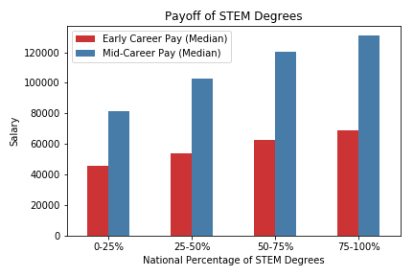
Findings - Value of STEM Major (cont.)
Bar chart to further model correlation between our two variables
Used pd.cut()/binning function to aggregate data
Notes:
Rohit

Slide 15
College Majors with the Best/Worst Return on Investment

Slide 16
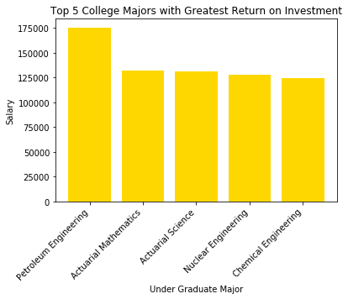
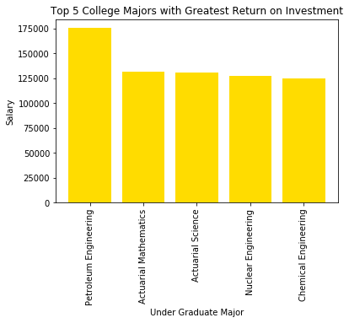
Data & Findings - College Majors with the Best Return on Investment
One thing we noticed was that the majors apart from Petroleum Engineering, has a relatively even distribution
They all range around the salary of $125,000 - $175,000
Notes:
Harita

Slide 17
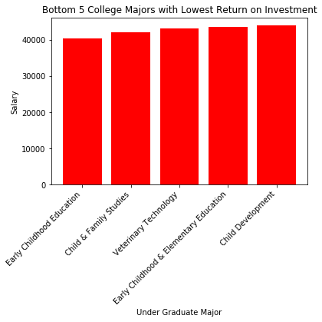
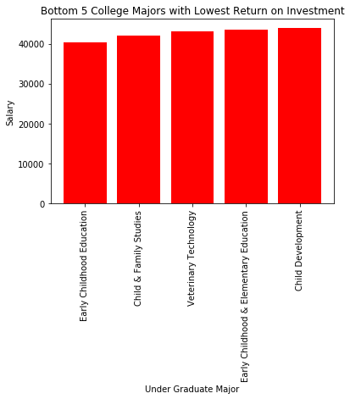
Data & Findings - College Majors with the Worst Return on Investment
The bottom 5 are very similar - They have to do with early childhood education
There is a significant difference between the pay scales of the top 5 and bottom 5 majors ($175,000 to $40,000, or $135,000)
All bottom five seem to be very close in pay, ranging around $40,000
Notes:
Harita

Slide 18
Conclusion
Education is a basic necessity for everyone. There is no compromise to it. But, the cost is based on the affordability and the ability to pay/ability to borrow.
Private colleges mostly tend to have good return on investment.
There is a correlation between school type and potential earnings
Pursuing a STEM degree has a positive impact on one’s potential earnings, both in the short and long-term
The top 5 majors with the greatest ROI are all in the realm of Science and the bottom 5 are centered around early childhood development.

